Slide 1
Node.js Workshop for backend
Session 3 : MVC and Databases

Slide 2
Table of contents
02
04
01
03
Databases
MongoDB
CRUD
Different types and when to use them
Familiarize ourselves with its structure and atlas
Use MongoDB driver for CRUD.
05
MVC
Wrap Up example
What is MVC and why we use it.
An example wrapping up the session deliverables

Slide 3
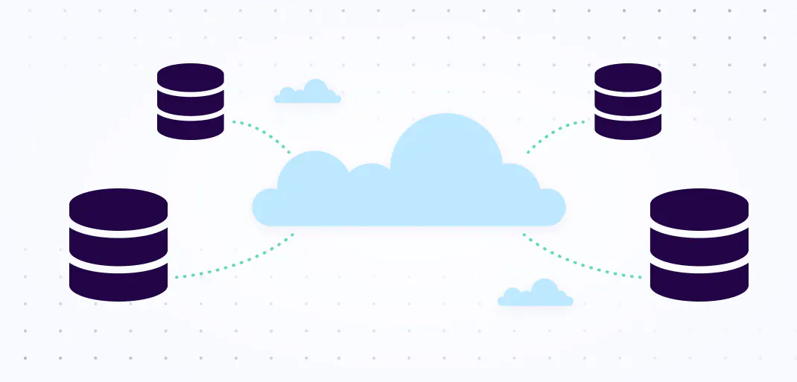
01
Databases
Different types and when to use them

Slide 4
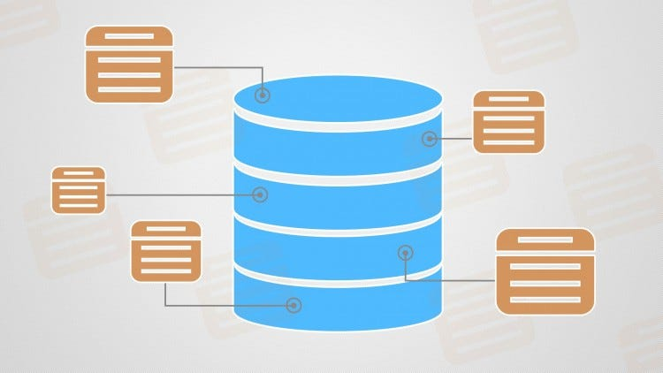
Databases
A database is a collection of data that is organized and stored in a way that makes it easy to access, manipulate, and analyze.
But Why don’t we just use data structures inside our code to organize the data if it’s not that big in size? Why use a database in that case?

Slide 5
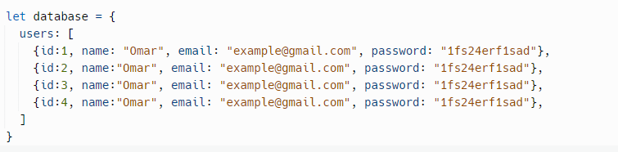
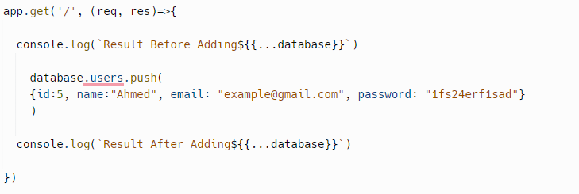
Incode Approach

Slide 6
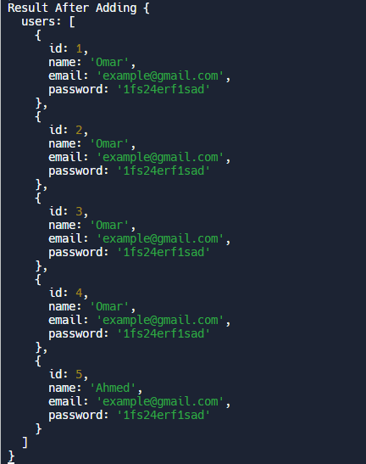
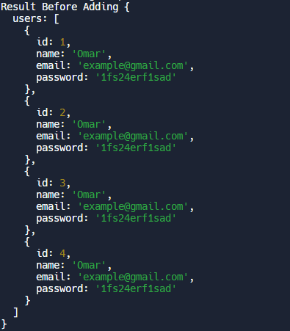
Incode Expected Output

Slide 7
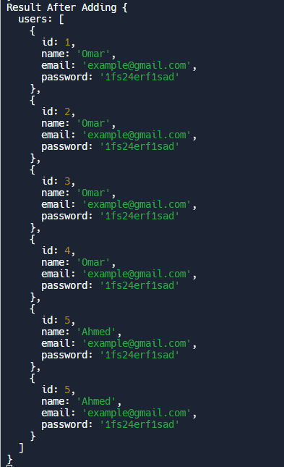
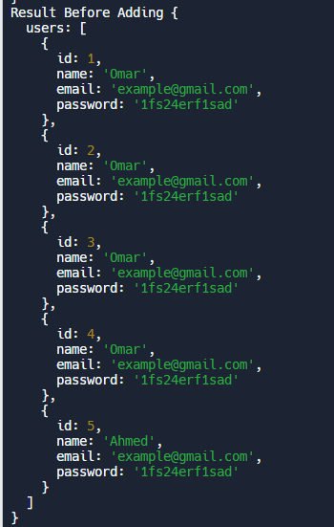
Incode Expected Output After Restart

Slide 8


Slide 9
Incode Actual Output After Restart

Slide 10
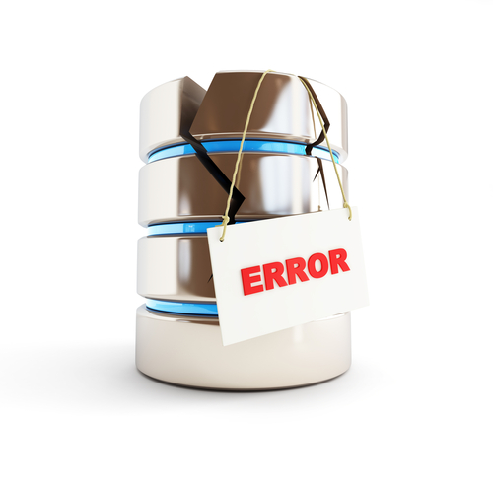
Persistency Conclusion
From the previous example we conclude that the database persists the data and protects it from being lost after a sudden crash or restart.

Slide 11
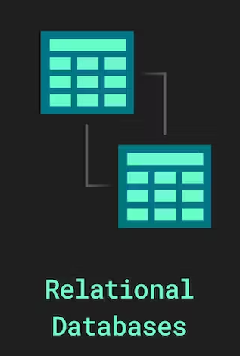
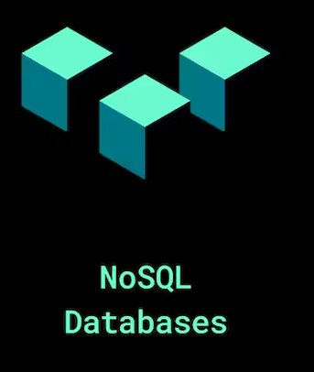
Database Types
Database types are the patterns and structures used to organize data within a database management system.
There are many different database types, but they can be broadly classified into three categories based on the model, location, and design of the data.
Focusing on the model of the data refers to how the data looks inside the database, and how it is stored, manipulated, and accessed.
Ex : Relational And Non-Relational models

Slide 12

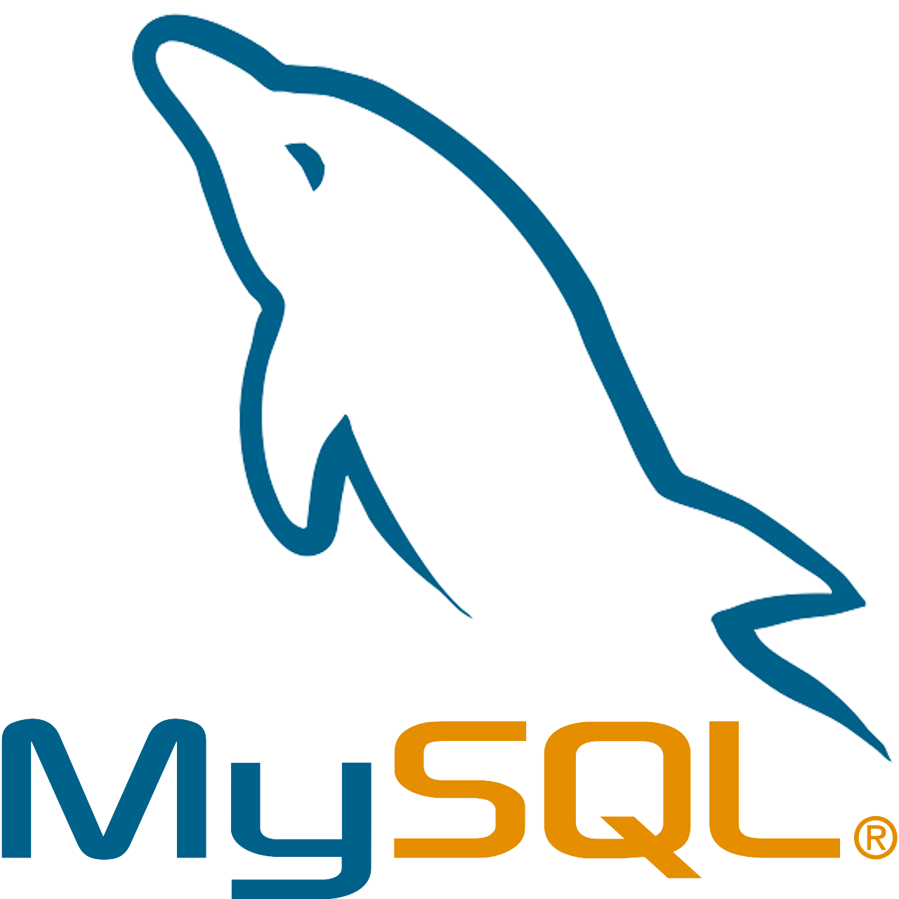
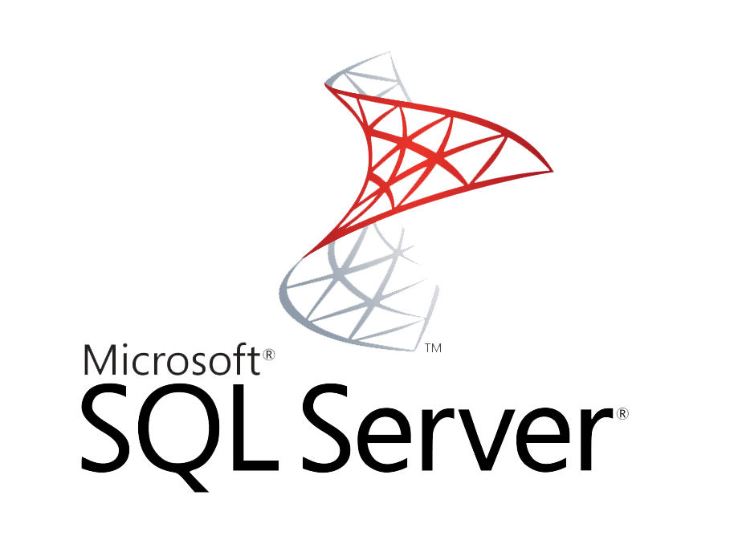
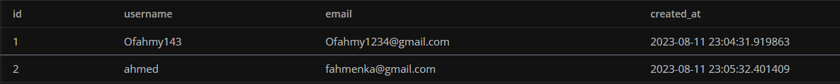
Relational Database Model
These are models in which data is stored in tables, where each row represents a record and each column represents a field. Relational databases use a structured query language (SQL) to manipulate the data. Examples of relational databases are MySQL, PostgreSQL, Oracle, and Microsoft SQL Server.

Slide 13
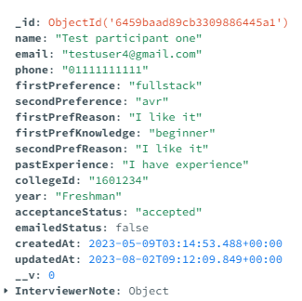
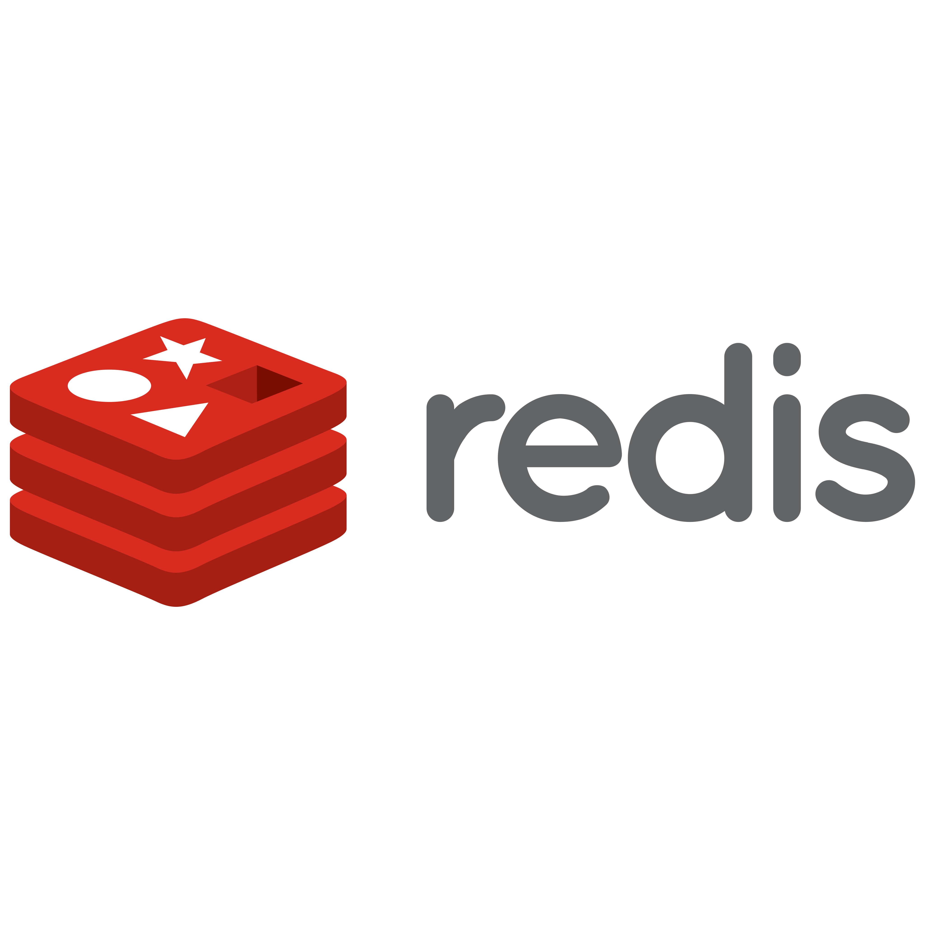
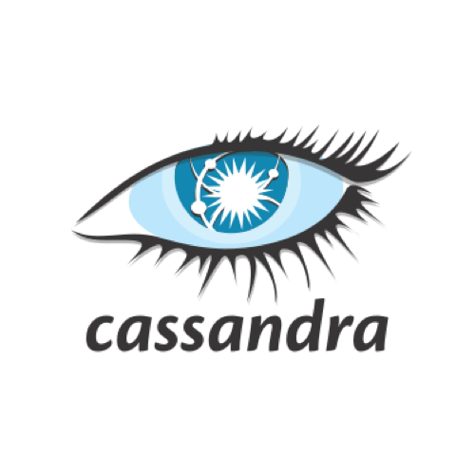

Non-Relational Database Model
Data is not organized in tables here, but in other formats such as documents, graphs, key-value pairs, or columns. NoSQL databases are more flexible and scalable than relational databases, but they may not support ACID transactions or complex queries.
Examples of NoSQL databases are MongoDB, Cassandra, Redis, and Neo4j.

Slide 14
When to use SQL vs No SQL
SQL | NOSQL
The data is structured and has a fixed schema. | The data is unstructured or semi-structured and has a dynamic schema.
The data needs to be queried using complex joins. | The data needs to be accessed using simple key-value or document-based queries.
The data does not need to scale or handle high volumes of unstructured data. | The data needs to handle high volumes of diverse data types, such as images, videos, or streams.

Slide 15

02
MongoDB
Familiarize ourselves with its structure and atlas

Slide 16
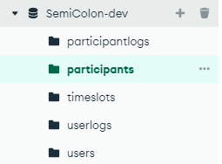
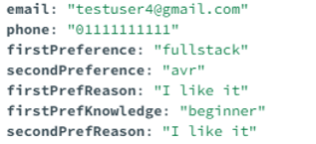
MongoDB
As we learned before MongoDB is a NoSQL database which means it does not use tables, rows, and columns to organize data, but instead uses documents, collections, and fields.
A collection is a group of documents that are related to each other.
A document is a piece of data that can have any number of fields.
A field is a name-value pair that represents an attribute of a document.

Slide 17

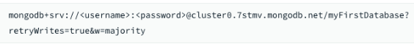
MongoDB Atlas
To use MongoDB, you need to install it on your computer or use a cloud service that provides MongoDB as a service, such as MongoDB Atlas.
STEPS
Create a new cluster in Mongo Atlas.
Create a new database inside that cluster.
Get the connection string for the specific database to connect programmatically.

Slide 18
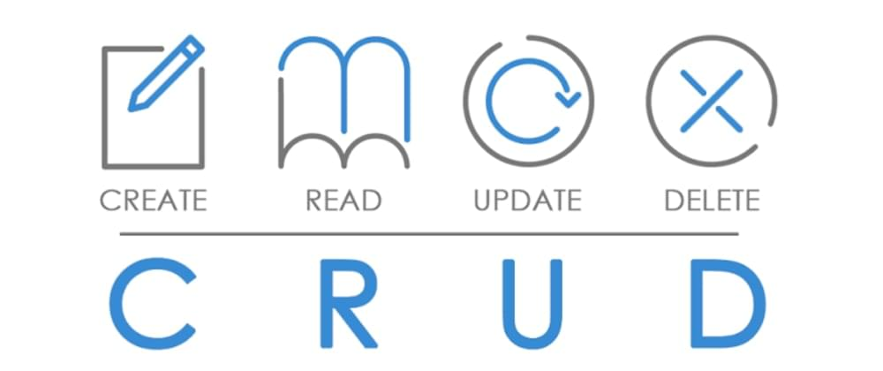
03
CRUD
Use MongoDB driver for CRUD

Slide 19
CRUD
CRUD is a term that stands for Create, Read, Update, and Delete. These are the four basic operations that you can do with data in a database.
Create: This means adding new data to the database. For example, you can create a new record of a user
Read: This means getting data from the database. For example, you can read the details of a user
Update: This means changing existing data in the database. For example, you can update the name of the user.
Delete: This means removing data from the database. For example, you can delete a user that is no longer active

Slide 20
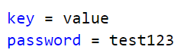
Environment Variables
It protects your sensitive data (such as passwords, keys , etc.) from being exposed as they are excluded from the version control system (Git)
You can choose whether to work on the production environment that is ready for end users or the one for testing and so on.
You can access all the env variables in node from the process.env object eg: process.env.PORT
The most common way to use these is to save the env variables in a .env file and use them using the dotenv package.

Slide 21

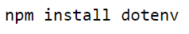
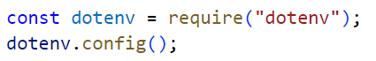
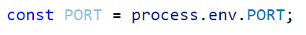
dotenv
It’s a package that allows you to load the env variables in the .env file onto the process.env object in node.
Installation Steps:
Install the package
Require the package and call the config function
Then you can call these values from inside the server using the process.env object

Slide 22
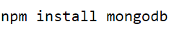
MongoDB driver
This is the driver that allows us to manipulate the mongodb database through our nodejs application
Installation Steps:
Install the driver package
Require the package
Connect the client to the mongo cluster
Get the database by it’s name
Get the collection by it’s name
Query the collection for desired documents

Slide 23
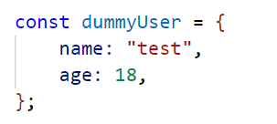
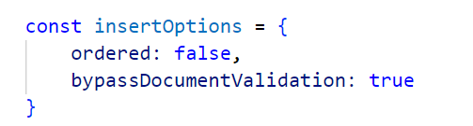
CREATE
When bulk inserting decides whether to abort at error or not
Can help you at testing route to bypass validation

Slide 24
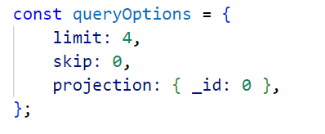
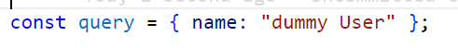
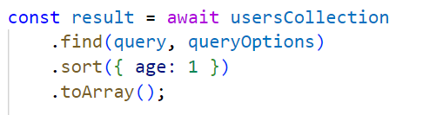
Read
Skips the first 2 records
Limit the response to only 4 records
Specify which fields to show
Cam use exclusion or inclusion mode

Slide 25
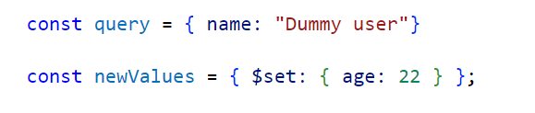
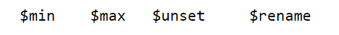
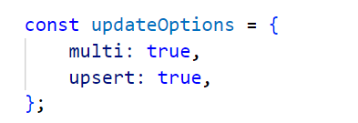
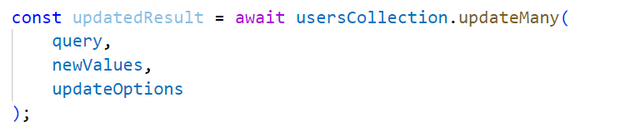
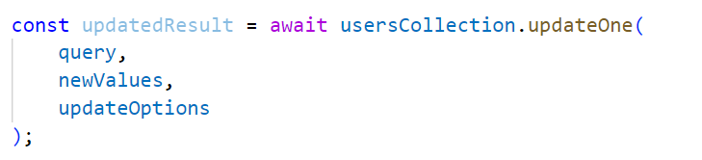
Update
Update multiple documents if found was used with deprecated method update
Create a new document with updated value if couldn’t find document

Slide 26
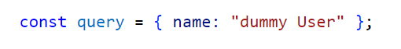
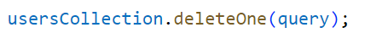
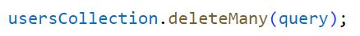
DELETE

Slide 27
Assignment 15 minutes
Convert The Assignment to use a real database
In the POST and PATCH route
Adding a new user then updating his name

Slide 28
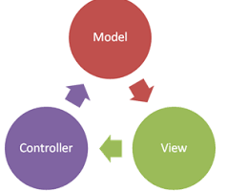
04
MVC Pattern
What is MVC and why we use it?

Slide 29
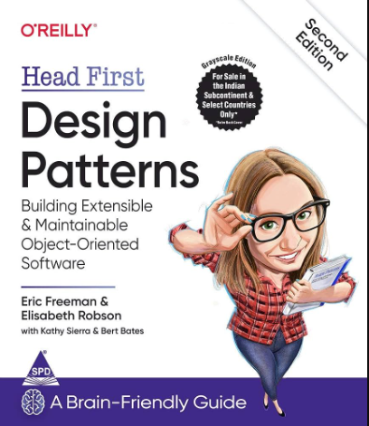
Design Patterns
Design Patterns are like a blueprint or a set of guidelines you follow to solve certain problems but not specific code.
Imagine them as recipes for making dishes they are a set of guidelines you follow to create readable, secure and easy to maintain project.
Head First Design patterns is a good way to dive into this topic.

Slide 30
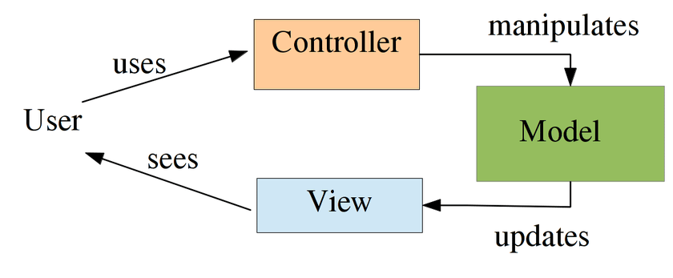
What is MVC?
MVC is an acronym for Model-View-Controller, which is a design pattern for structuring web applications.
It helps to separate the logic, presentation, and data of an application, making it easier to maintain and extend.

Slide 31
Model
This is the layer that manages the data of the application and interacts with the database and defines the structure and behavior of the data.
For example, you can use a package like Mongodb to interact and manipulate MongoDB collections.

Slide 32
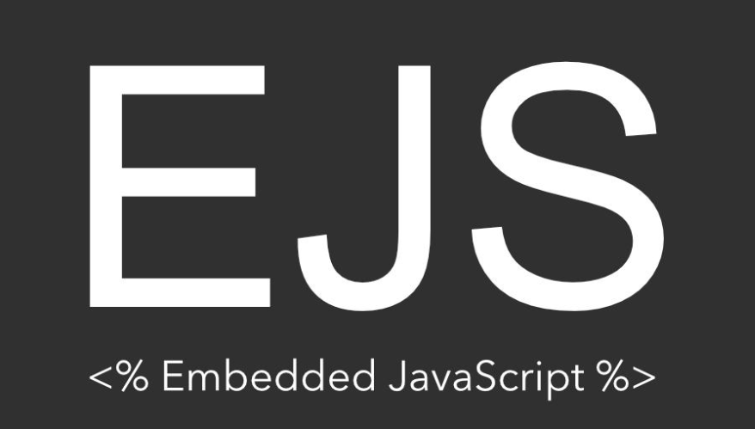
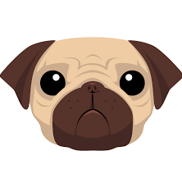
View
The view is responsible for presenting the data of the application to the user, such as rendering HTML pages, images, or other user interface elements.
This is the dining room, where the food is served and displayed to the customers.
You can use a template engine like EJS or Pug to create dynamic HTML pages that insert data from your model. Template engines allow you to write HTML code with embedded JavaScript expressions or variables that are evaluated at runtime.

Slide 33
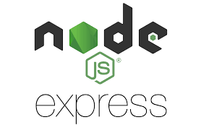
Controller
The controller is responsible for handling the requests from the user and coordinating with the model and the view.
You can use Express routing to define different endpoints for different HTTP methods and actions, such as GET, POST, PUT, or DELETE.

Slide 34
Restaurant Analogy
The Model is Like the kitchen where the food is being prepared and stored
The Controller is the waiter, who takes the orders from the customers and communicates with the kitchen and the dining room.
The View is the dining table that the food is being served on infront of the customers

Slide 35
Extra Structure
Routers: We separate the call back controller from the express app route to separate concerns as leaving the routes in a file of it’s own and controller login in a file.
Utils: We can add global utility functions in a folder of it’s own for a more organized structure and removing redundancy and duplicate code.
Services: Any configuration of a service used is kept by it’s own in the services folder for better maintenance of the code (changing configs).
Middleware: As previously discussed middleware don’t fit in any of the mentioned structures thus kept in a folder of it’s own for better structure.

Slide 36
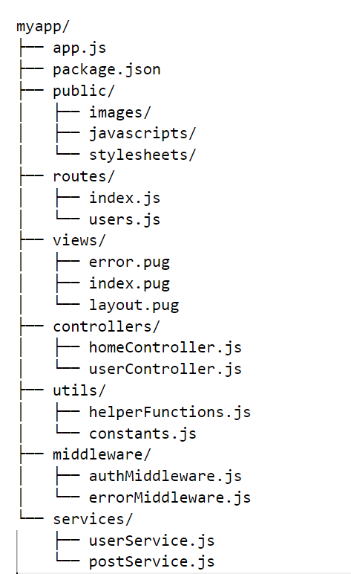
File Structure Visualized

Slide 37
Assignment 15 minutes
Change The Previous Assignment structure into MVC

Slide 38

Extra Read
ODM
What is ODM and why use it

Slide 39
ODM
ODMs are Object Document Mappers, which are libraries that help you work with non-relational databases, such as MongoDB, by providing an abstraction layer that maps the data between the database and the application.
The most popular ODM in use nowadays is Mongoose which is mainly used with Mongodb.

Slide 40
ODM
allow you to define schemas and models for your data, which can enforce validation, default values, and custom methods. For example, you can use Mongoose as an ODM for MongoDB to create schemas and models for your collections.
ODMs provide methods to perform CRUD (create, read, update, delete) operations on your data Which simplifies the syntax.

Slide 41
TASK
allow you to define schemas and models for your data, which can enforce validation, default values, and custom methods. For example, you can use Mongoose as an ODM for MongoDB to create schemas and models for your collections.
ODMs provide methods to perform CRUD (create, read, update, delete) operations on your data Which simplifies the syntax.

